Slide 1
Fundamentals of Networks and Security
Vassilis Markos
Mediterranean College
Week 06

Slide 2
A Quick Revision

Slide 3
What we saw last time…1 / n
Name some network design principles.
Good Network Design Principles:
Internal accessibility (you should have access to any device you need to)
External access (see and show what you should from / to the world)
Logical security (take care of security at the design level of the network)
Physical security (remember those firewalls?)
High transfer speed / minimal delays (www.google.com should load instantly)
Reliability and Resilience (you should not fear that you will get disconnected every time the clock ticks)
Adaptable to extensions / future needs (you should not build a network only for today)

Slide 4
What we saw last time…2 / n
What is network topology?
Network Topology is the arrangement of the elements (links, nodes, etc.) of a communication network.
Name some popular network topologies.
Some topologies:
Star → Popular, reliable.
Ring → Somewhat unreliable.
Bus → Cheap, easy to get bus-y (?)
Wireless (like bus)

Slide 5
What we saw last time…3 / n
What is a collision domain?
A Collision Domain is the LAN part (segment) where devices must compete to communicate.
What is a broadcast domain?
The part of the network where a message can be “heard”.
Right or Wrong? Switches create one collision domain and multiple broadcast domains.
Wrong. Switches split the collision domain to each port and a single broadcast domain.

Slide 6
What we saw last time… 4 / n
What would you consider when looking for network devices?
Indicatively:
Cost
Connectivity (e.g., number of ports)
Network speed (hopefully better than your current equipment)
The future (Is it expandable? Easy to maintain?)
Comprehension (Can you understand how to use it? Can your colleagues?)

Slide 7
What we saw last time… 5 / n
What are Single Points of Failure?
Parts of the network that if a failure occurs you have no back-up plan.
How to address SPF?
Introducing redundancies to network links and parts, i.e., by using back-up plans.
What do Firewalls filter?
Some examples:
packets, e.g., Stateful Packet Inspection (SPI): incoming packets must correspond to some request,
applications, e.g., your typical OS Firewall,
URL

Slide 8
What we saw last time… 6 / n
What are the three layers of the Hierarchical Network Design?
The three layers are:
Access layer: User-level access to the network.
Distribution layer: Policy-based access.
Core layer: Lower-level access → fast communication between switches.
What is the Collapsed Core Layer?
Often, distribution and core layers are implemented by the same devices, leading to cost reduction without significant losses.

Slide 9
Network Design (revisited)

Slide 10
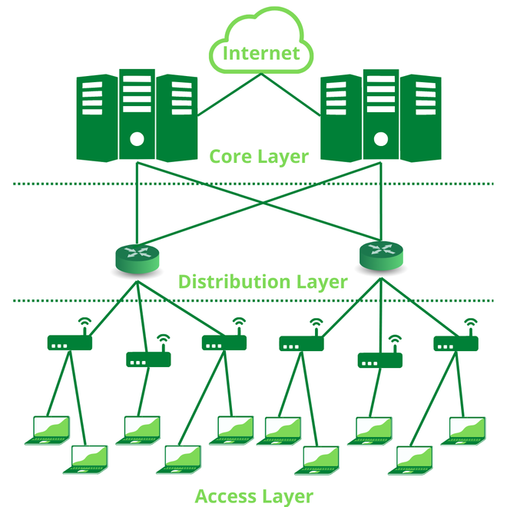
(Reminder) Hierarchical Network Design
Access layer: User-level access to the network.
Distribution layer: Policy-based access.
Core layer: Lower-level access → fast communication between switches.

Slide 11
(Reminder) Access Layer
Layer 2 switches.
Requirements:
High availability
Port security
How is (electric) power transmitted?
Power over Ethernet (PoE): Power “travels” through Ethernet twisted-pair cables alongside data.
Quality of Service (QoS): What is this?
The quality of service offered to you by the network, e.g., measured when you run a network speed test.

Slide 12
(Reminder) Distribution Layer
Multiple LAN / WAN links - scaling by using more “stuff”.
Redundancy.
Routing.
In general, Layer 3 (network) services.
What about security?
Packet filtering.

Slide 13
(Reminder) Core Layer
High-speed switching:
Implemented at the physical / hardware level.
Reliability and fault tolerance.
Scaling not by using more but faster devices.
Lower level.
Higher level processing of bulk information is avoided.
Collapsed Core Layer: Often, distribution and core layers are implemented by the same devices, leading to cost reduction without significant losses.

Slide 14
(Reminder) 50 Shades of… Cloud?
LAN:
Something “clever”
This is not the so-called “cloud”!
Clever

Slide 15
(Reminder) 50 Shades of… Cloud?
All clouds below are pretty little LAN.
How could we connect many LAN?
LAN2
LAN1
LAN3
“Amazingly clever”
LAN5
LAN4

Slide 16

(Reminder) 50 Shades of… Cloud?
The Internet is a network of networks, i.e., a Wide Area Network (WAN).
Each device and sub-network uses unique addresses to identify itself (How do we call them?).
Routers are used to connect local networks to the rest of the world.
“The Internet”
Local Network
You

Slide 17
Network Design: An Example
Scenario: “Engine-ear” is a sound-engineering company with the following specs:
4 Departments of 18 users each: Sales, Development, Production, Payroll / HR.
One printer on each floor.
All user devices are (un)fortunately MS-based.
Private IP addressing.
Core network provides all network services (DHCP, DNS, Auth, File Storage).
DSL broadband Internet connection.
Layout: 7 rooms over 4 floors as follows:
Ground: Reception (part of Sales) & Production
First: Production
Second: Development & Sales
Third: Payroll / HR & Secure storage room.

Slide 18
How many clouds?
6 clouds! Don’t forget printers + core!
How would you connect the Sales Department (Ground / 2nd floor, 18 users)?
Take 1: 18 users + 1 connection to core = 19 ports?
But, what about SFP (Single Failure Points)?
Take 2: 18 users + 1 connection to core + 1 redundant connection to core = 20 ports! So, we need a layer 2 switch with at least 20 ports!
Look up those two alternatives:
Cisco 2960.
Cisco 1000
Which would you prefer?

Slide 19
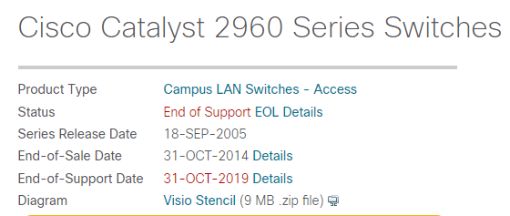
Cisco 2960

Slide 20
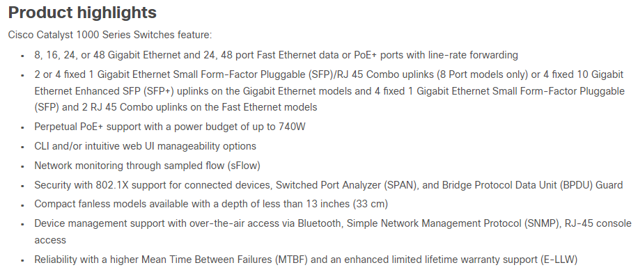
Cisco 1000

Slide 21
Connecting Clouds
How to connect our six clouds?
Via Layer 3 switches / Routers (those will serve as gateway ports).
How many ports?
Since we have six clouds, at least 6!
Why at least?
There is also the outer world + think future!
Fast Ethernet (FE) or Gigabit Ethernet (GE)?
Since we chose GE Layer 2 Switches, we must choose GE Layer 3 devices, otherwise we would bottleneck our own network (bad for your course assignment, too!)
Look around the internet for a reasonable choice.
What did you find? How does it cost?

Slide 22

(Reminder) Careless in the Abyss
I CAN SEE OTHERS’ DEVICES!
BUT, THIS MEANS THEY CAN SEE MINE, TOO?
INTERNETWORKING IS REALLY AMAZING!
Adapted from Adam Ellis.

Slide 23
Setting up Firewalls
Firewalls act as filters between you (your network) and the world (aka Internet).
Additional router(s) might be needed to connect the outside network (usually Ethernet based) to the (ADSL based) Internet connection.
Many routers have their own internal firewall (ISR: Integrated Services Router).
We often have internal firewalls, i.e., between departments. Why?
To avoid potential damage at one place spreading to others.
To avoid internal breaches.
To ensure people at your business do (only) what they are supposed to.

Slide 24
Setting up (just that)
Mention some cases of potential physical threats against equipment:
Temperature (Heat / Cold)
Fires / Earthquakes / Natural disasters
Users
Unauthorised users…
How to protect against them?
Physical containers (put your precious machines in protective boxes)
Choose places with limited access (e.g., areas where you can observe, or where there is no free access or where access is noticeable).

Slide 25
Setting up (again)
Is it a good idea to have all equipment in one place?
Heat?
Voltage?
Is it good to split connections?
Cost?
Complexity?
Things to take into account:
Distance: When is short physical distance beneficial? When not?
Reliability? Avoiding RFI / EMI?
When choosing cables, also remember that this affects other device choices! E.g., some switches do not support fibre, only TP.

Slide 26
More on Connectivity
Consider creating redundancies:
How many more ports?
At what cost?
What about power?
WAP, IP Phones etc → PoE (quite often)
Where to put all those cables?
Below employees feet?
Over their heads?
Inside the wall?

Slide 27
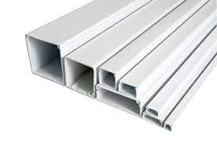
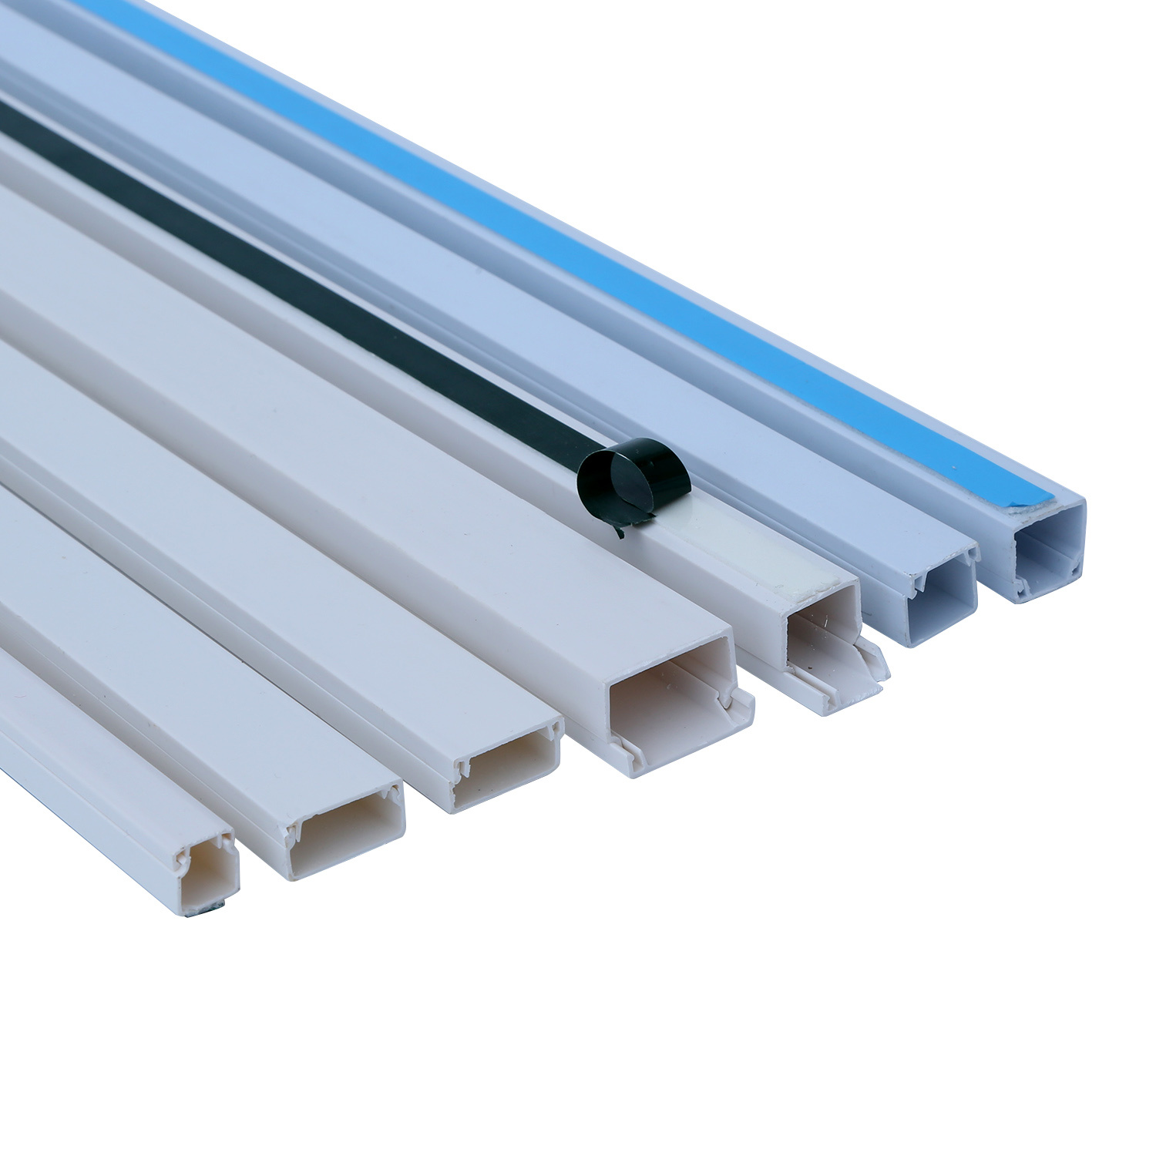
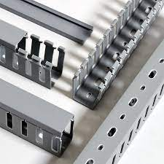
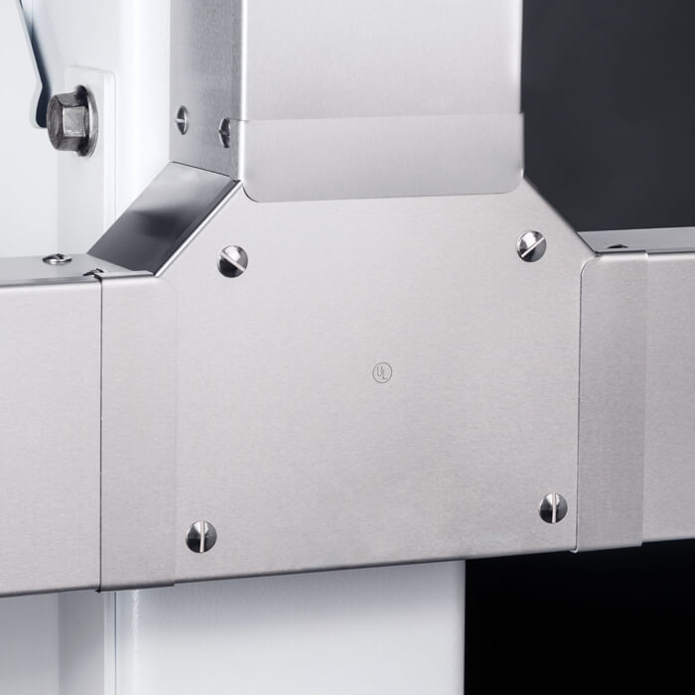
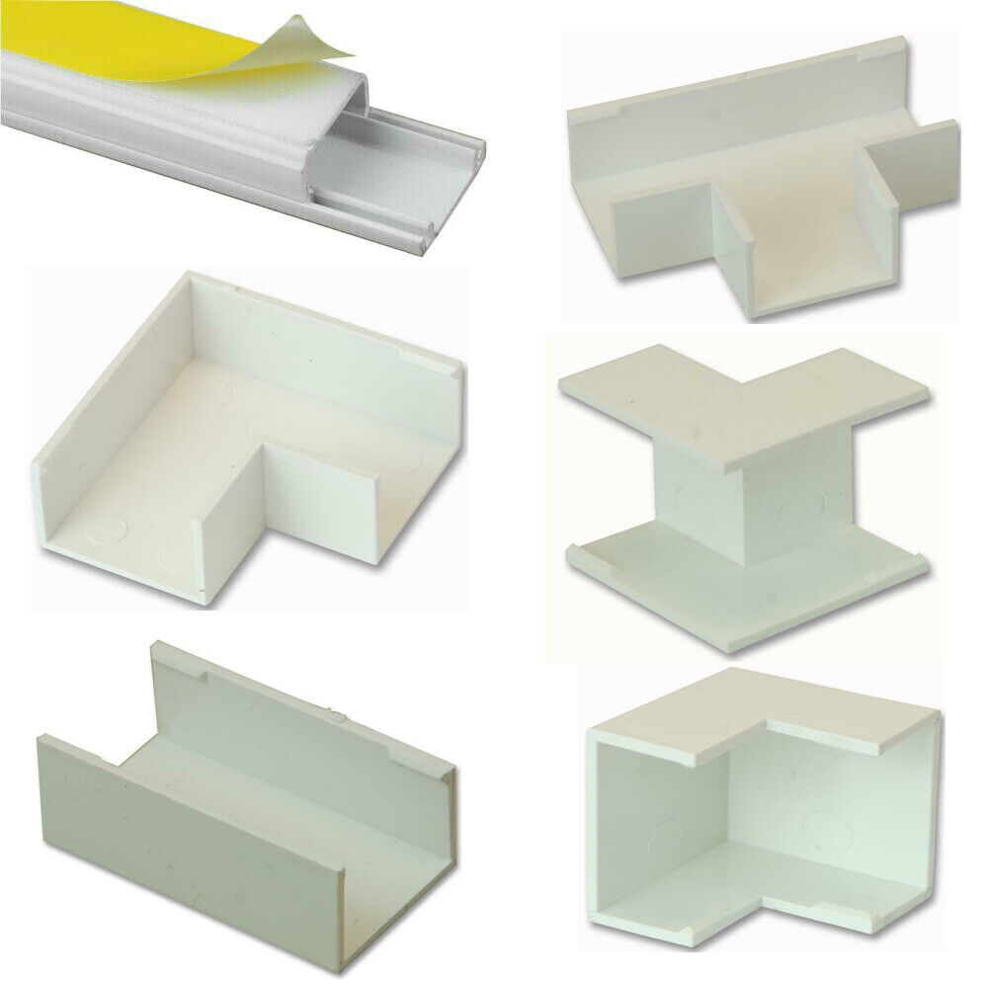
Trunking

Slide 28
Trunking (aka Cable Containment)
Where? Behind desks? Above / below windows? Close to the floor
Higher up means more difficult to access → Maintenance.
Lower down means easier to access but also to damage → Maintenance.
Aesthetics may also come into play here…
Some ideas / hints / things you might not know:
You can pass a trunk through a wall to connect adjacent rooms.
You can do so through a ceiling to connect adjacent floors.
You cannot do so through doors (guess why).
Take advantage of ceiling voids! (the gap between the actual and false ceilings).

Slide 29
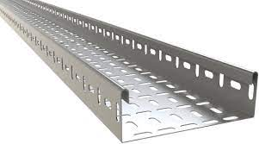
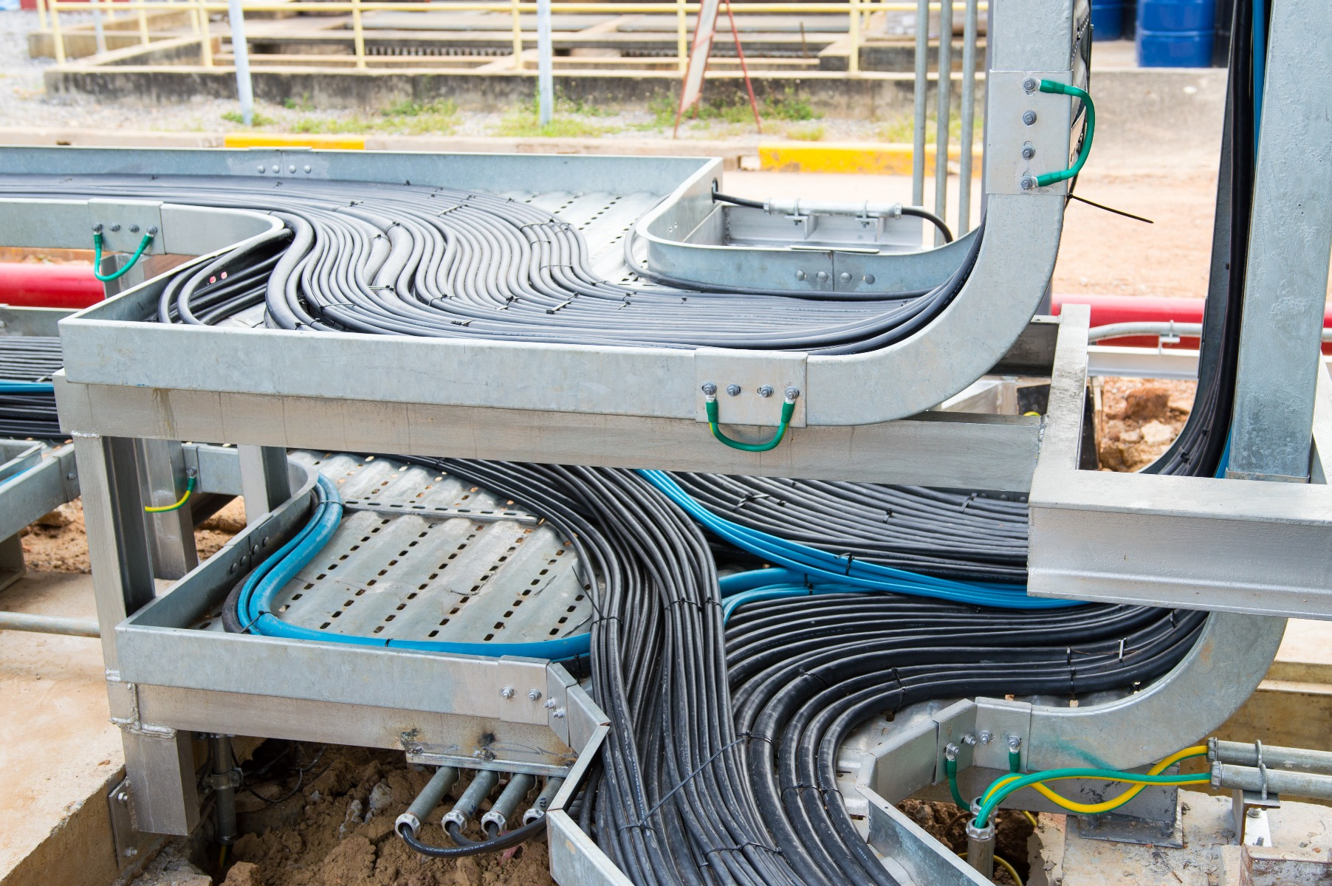
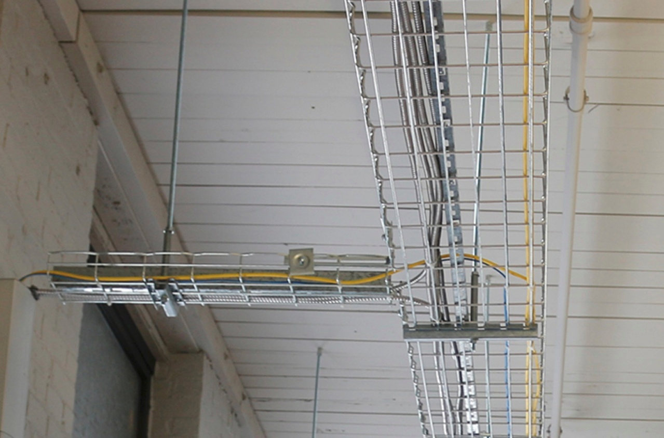
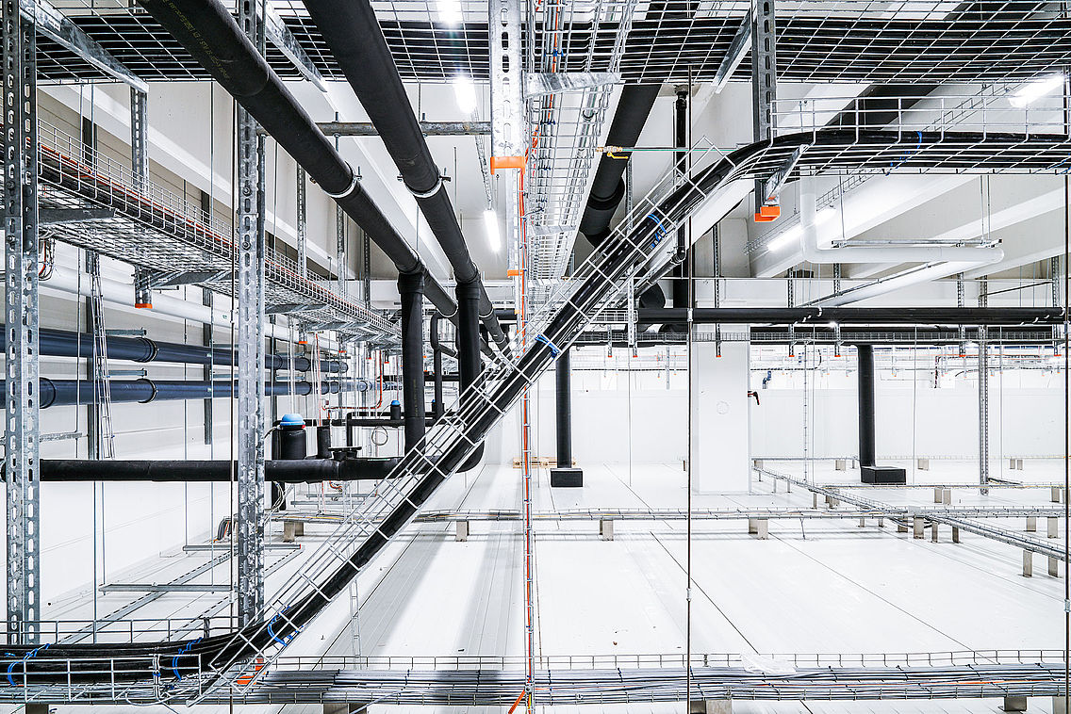
Some Cable Trays

Slide 30
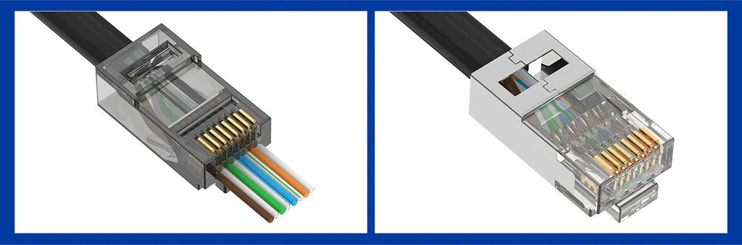
RJ45, 8P8C and other spells…

Slide 31
RJ45
RJ45 → Registered Jack 45
Useful to connect user devices with network core / other devices.
You just have to plug / unplug the device - the rest is taken care of by RJ45 and network cabling.
Typical in most network cabling.
You can read more here: https://www.vcelink.com/blogs/focus/rj45-connector-101
You can always also consider wireless…
How to connect WAP?
As all other devices.
Take into account power (PoE?).

Slide 32
What we saw today… 1 / n
Name some things to consider when buying network equipment.
A few things to take into account are:
Cost
Connectivity (e.g., ports on switches / routers)
Availability
Usability
The future.

Slide 33
What we saw today… 2 / n
Why install a firewall between two departments of the same business?
Some reasons include:
To avoid potential damage at one place spreading to others.
To avoid internal breaches.
To ensure people at your business do (only) what they are supposed to.
How to protect network devices against physical damage?
Some ways are:
Physical containers (put your precious machines in protective boxes)
Choose places with limited access (e.g., areas where you can observe, or where there is no free access or where access is noticeable).

Slide 34
What we saw today… 3 / n
Which things you should consider when placing equipment?
Some important things include:
Heat and voltage.
Physical distance.
Cost and complexity.
RFI / EMI.
Reliability.

Slide 35
What we saw today… 4 / n
Best and worst practices about trunking include…
Passing a trunk through a wall to connect adjacent rooms.
You can do so through a ceiling to connect adjacent floors.
You cannot do so through doors (guess why).
Take advantage of ceiling voids! (the gap between the actual and false ceilings).

Slide 36
Homework
This is a bi-weekly assignment (it will span two weeks, so make your time management accordingly).
Read the following chapter found in ‘Our Stuff > network_design_principles.pdf’.
Provide a summary of at least 700 words of the main concepts of this chapter.
The aim of this assignment is to help you in summarising stuff you find from certain source. Avoid using the same wording / phrasing as in the book. Try to be as concise and accurate as possible and try to not go too much beyond 700 words (1000 words is acceptable, 2000 words is not).

Slide 37
Fun Time!

Slide 38
Network Design
Complete any previous homework you didn’t have time to: ‘2.1.1.5 Packet Tracer - Create a Simple Network Using Packet Tracer’
Follow this Tutorial: ‘Derby Stuff > Tutorial > 4.2.4.4 Packet Tracer - Connecting a Wired and Wireless LAN.pka’
Follow this Tutorial: ‘Derby Stuff > Tutorial > drawing packages.pdf’
Follow this Tutorial: ‘Derby Stuff > Tutorial > Week 5 Tutorial - Using Wireshark to Examine Ethernet Frames.pdf’

Slide 39
(Reminder) NetAcad Courses
In the “Download Packet Tracer” page, above the “Download” section, you can find three interesting courses (interesting course: a course is characterised as “interesting” to inform someone that they should take it, without telling them to do so directly):
Getting Started with Cisco Packet Tracer
Exploring Networking with Cisco Packet Tracer
Exploring IoT with Cisco Packet Tracer
Also interesting is the following NetAcad course:
Network Technician

Slide 40

Any Questions?
Don’t forget to fill-in the questionnaire! (look right)
https://forms.gle/6q2tuByroaan8kWH8

